Slide 1
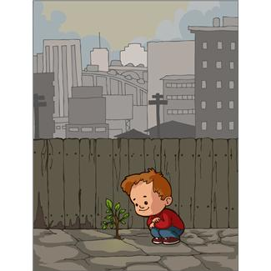
Places in Town

Slide 2
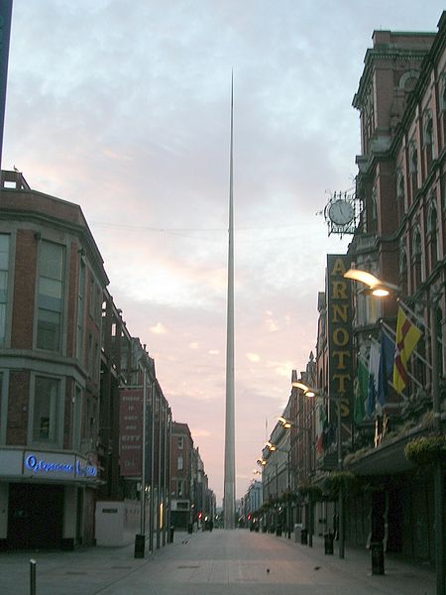
street

Slide 3
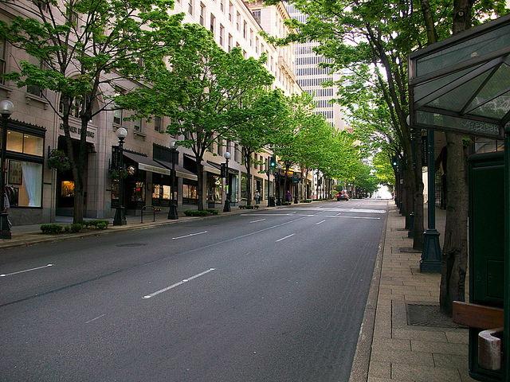
avenue
http://www.flickr.com/photos/jordan_mac/4846866559/sizes/z/in/photostream/

Slide 4
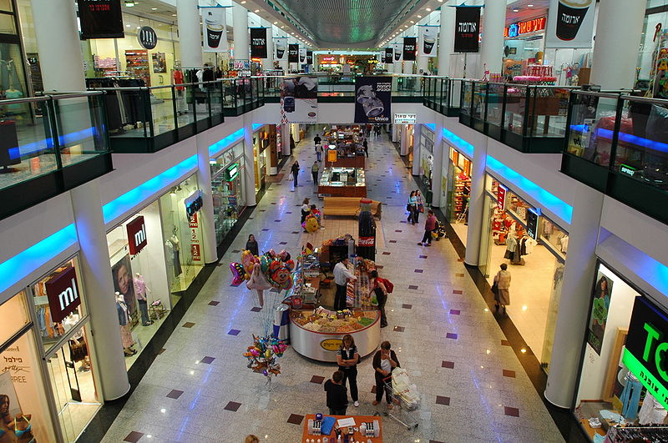
mall
http://he.wikipedia.org/wiki/%D7%A7%D7%95%D7%91%D7%A5:Haifa_9568.JPG

Slide 5
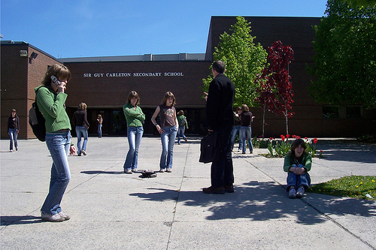
school
http://www.flickr.com/search/?z=e&w=all&q=school&m=text

Slide 6
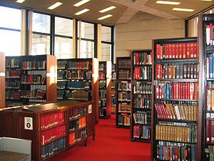
library

Slide 7
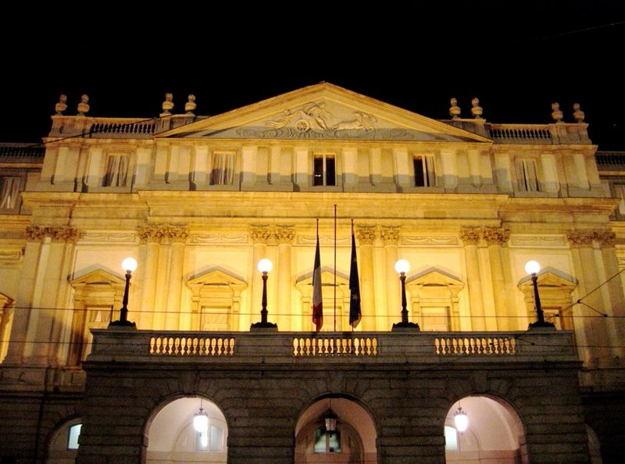
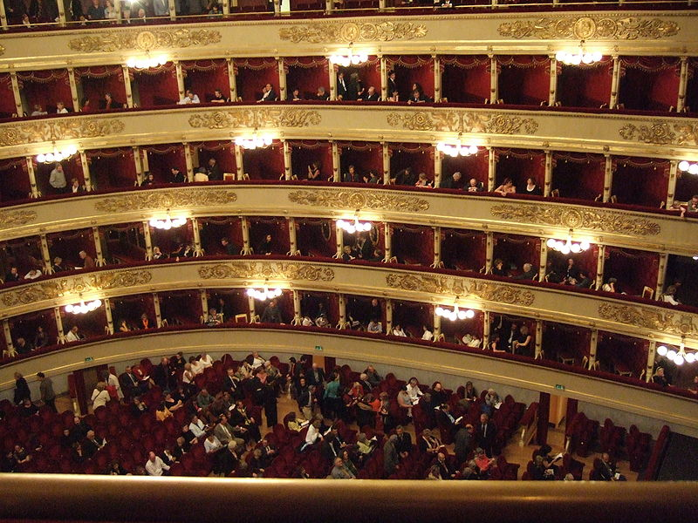
theater

Slide 8
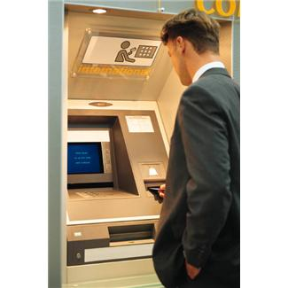
bank

Slide 9
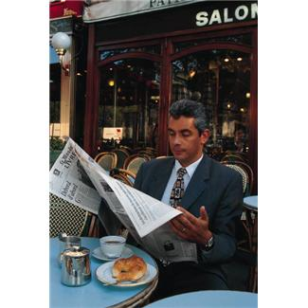
cafe’

Slide 10
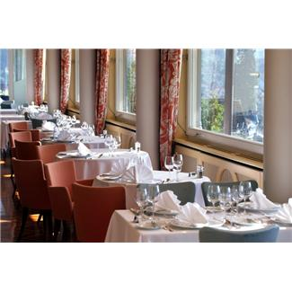
restaurant

Slide 11
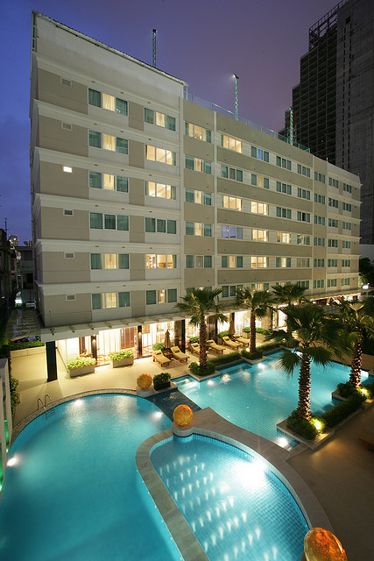
hotel
http://www.flickr.com/photos/35497198@N06/3288838415/sizes/z/in/photostream/

Slide 12
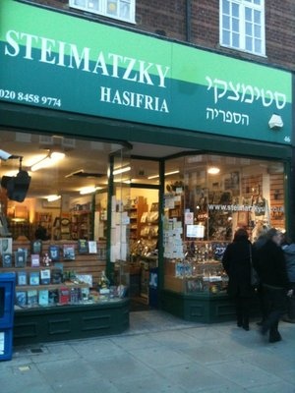
bookstore
http://www.yelp.co.uk/biz/steimatzky-hasifria-london

Slide 13
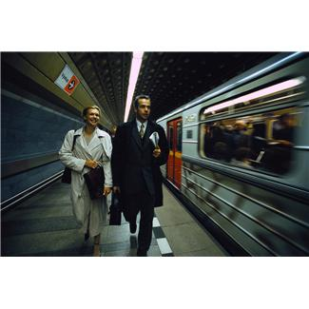
subway station

Slide 14
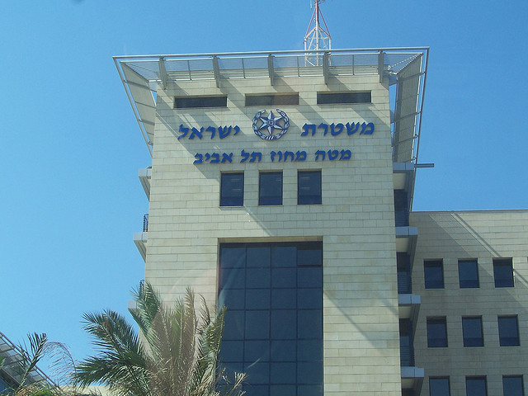
police station
http://www.flickr.com/photos/dukesdream/819377506/sizes/z/in/photostream/

Slide 15
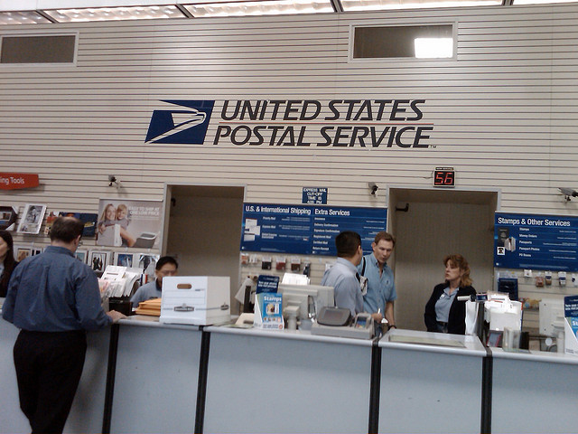
post office
http://www.flickr.com/photos/boutmuet/3364268637/sizes/z/in/photostream/

Slide 16
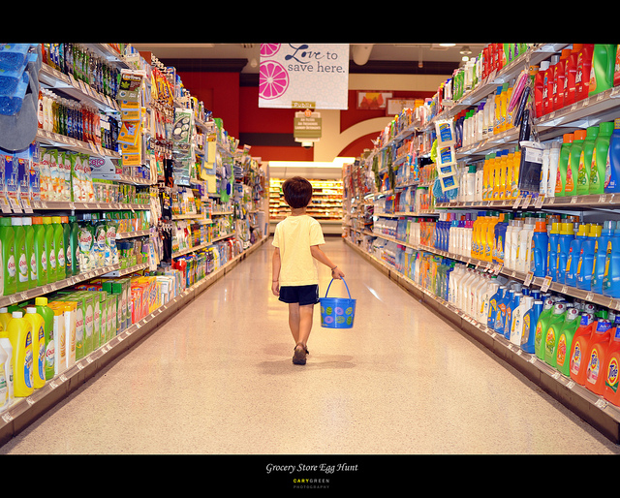
grocery store
http://www.flickr.com/photos/52944256@N04/5646437894/sizes/z/in/photostream/

Slide 17
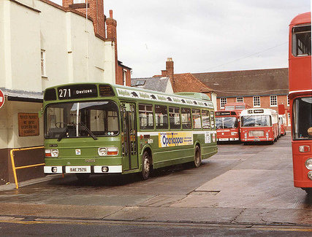
bus station
http://www.flickr.com/photos/reynardbizzar/2198345352/sizes/m/in/photostream/

Slide 18
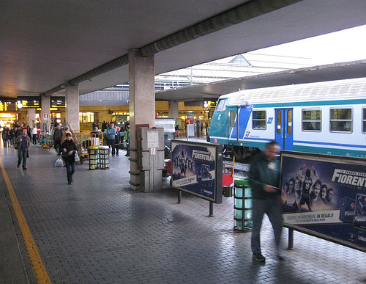
train station
http://www.flickr.com/photos/aroundtuscany/4554808490/sizes/m/in/photostream/

